Slide 1
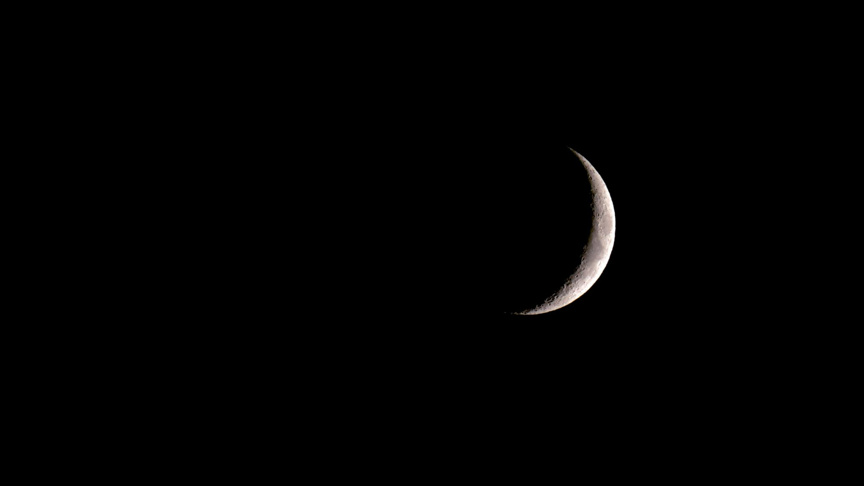

Hazardous Asteroid prediction using ML models
Vishanth Reddy battula
Vignesh Matam
Spandana Pasupulaty

Slide 2
Contents
Abstract
Introduction
Objectives
Literature review
Challenges in Existing System
Proposed Methodology
System Architecture
Dataset Description
Machine learning Models
Implementation Process
Results and Analysis
Challenges Faced
Conclusion
Future Work

Slide 3
Abstract
Asteroids orbit the Sun, and while most pose no immediate threat, some can come dangerously close to Earth. Early detection of these hazardous asteroids is critical for mitigating potential impacts. This project leverages machine learning techniques to classify asteroids as hazardous or non-hazardous based on various features like size, speed, and proximity to Earth. The dataset used includes 4688 records and 40 features sourced from NASA’s Jet Propulsion Laboratory (JPL). Several machine learning models, including Logistic Regression, Random Forest, and Deep Neural Networks, were applied to determine the most accurate predictive system. The results highlight the potential of machine learning in improving detection accuracy and enhancing global preparedness against asteroid threats.

Slide 4
Introduction
Asteroids are rocky objects orbiting the Sun, remnants from the early solar system. Some of these, known as Near-Earth Objects (NEOs), have orbits bringing them close to Earth, raising concerns about potential impacts. Detecting these hazardous asteroids is vital to avert catastrophic events. Traditionally, astronomers manually analyze asteroid data, but the sheer volume of information makes this task daunting. Machine learning offers a faster, more accurate alternative by analyzing large datasets, identifying patterns, and predicting potential risks. This project explores using machine learning models to classify asteroids as hazardous or non-hazardous, emphasizing the importance of this technology in planetary defense.

Slide 5
Objectives
The primary objective is to develop a machine learning-based system that can classify asteroids as hazardous or non-hazardous. This involves:
Compiling and preprocessing a dataset containing detailed asteroid observations.
Applying various machine learning models to classify the data.
Comparing the performance of different models to identify the most accurate and reliable one.
Addressing challenges such as imbalanced datasets, missing values, and overfitting.
Ensuring the results contribute to improving planetary defense strategies by providing accurate and actionable insights about hazardous asteroids.

Slide 6
Literature review
Existing studies highlight the potential of machine learning in asteroid detection. For example, Random Forest models have shown high accuracy in classification tasks due to their ability to handle large datasets and complex patterns. Logistic Regression has proven effective in binary classifications, such as hazardous vs. non-hazardous. Other studies emphasize the importance of feature selection to improve model accuracy. Advanced methods like Deep Neural Networks (DNN) are also gaining popularity for their capability to model intricate relationships within data. These findings inspired our approach, which combines insights from literature with real-world data from NASA JPL to build and evaluate predictive models.

Slide 7
Challenges in Existing System
Current systems face several challenges:
Data Complexity: Astronomical datasets are vast and contain numerous features, making manual analysis impractical.
Imbalanced Data: Most datasets have fewer hazardous asteroid instances compared to non-hazardous ones, leading to biased predictions.
Missing Values: Missing or incomplete data reduces model accuracy.
Overfitting: Some models perform well on training data but fail on unseen data, limiting real-world applicability.
Computational Limitations: Processing large datasets requires significant computational resources, making it challenging for resource-constrained systems.

Slide 8
Proposed Methodology
The proposed methodology involves:
Data Collection: Dataset sourced from NASA JPL with 4688 rows and 40 features.
Preprocessing: Handling missing values, normalizing data, and balancing the dataset.
Feature Selection: Using heatmaps to identify relevant attributes.
Model Training: Implementing models like Naïve Bayes, Logistic Regression, Random Forest, Decision Tree, KNN, SVM, and DNN.
Evaluation: Comparing models using metrics like accuracy, precision, recall, and F1-score to identify the best-performing algorithm.

Slide 9
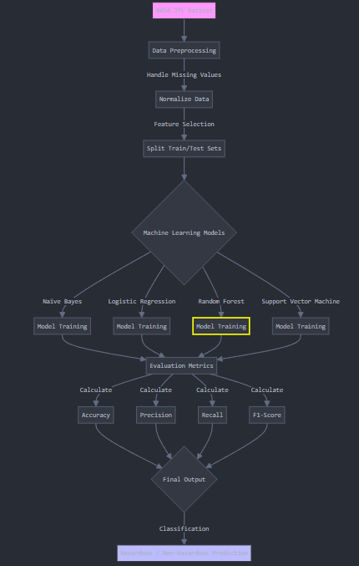
System Architecture
Components:
Data Source: Dataset from NASA JPL with features like size, velocity, and proximity to Earth.
Data Preprocessing: Handle missing values, normalize data, select relevant features, and split into training/testing sets.
Machine Learning Models: Train models like Naïve Bayes, Logistic Regression, Random Forest, and SVM. Fine-tune hyperparameters for better performance.
Evaluation Metrics: Use accuracy, precision, recall, F1-score, and confusion matrices to assess model performance.
Output: Classify asteroids as Hazardous or Non-Hazardous and highlight the most accurate model.

Slide 10
Dataset Description
The dataset, obtained from NASA JPL, contains detailed observations of asteroids, including:
Attributes: Size, velocity, proximity to Earth, brightness magnitude, etc.
Rows and Features: 4688 rows and 40 features.
Preprocessing Steps:
  Removed redundant and irrelevant columns.
  Handled missing values using imputation techniques.
  Balanced the dataset to address bias issues.
  Normalized numerical attributes for better model performance.

Slide 11
Machine Learning Models
Naïve Bayes: A simple probabilistic model effective for text and categorical data.
Logistic Regression: Used for binary outcomes like hazardous vs. non-hazardous.
Random Forest: An ensemble method known for its robustness and high accuracy.
KNN: Classifies data points based on their similarity to neighbors.
Decision Tree: A visual and interpretable model for decision-making.
SVM: Finds a hyperplane that separates data points into categories.
DNN: Models complex patterns using multiple interconnected layers.

Slide 12
Implementation Process
Data Split: 70% for training, 30% for testing.
Libraries Used: Python libraries like sklearn, Keras, Pandas, and Matplotlib.
Training: Trained models using cross-validation to avoid overfitting.
Evaluation: Analyzed performance using accuracy, confusion matrices, and precision-recall curves.
Visualization: Used heatmaps and charts to interpret results.

Slide 13
Results and Analysis
Top Performing Models: Random Forest and DNN outperformed others with high accuracy and precision.
Visuals: Accuracy comparison charts and confusion matrices highlight model performance.
Insights: Addressed overfitting by optimizing hyperparameters.

Slide 14
Challenges Faced
Data Imbalance: Mitigated using oversampling and under sampling techniques.
Overfitting: Resolved through cross-validation and regularization methods.
Computational Resources: Used efficient libraries and cloud-based solutions for large-scale computations.

Slide 15
Conclusion
The study demonstrates the potential of machine learning in classifying hazardous asteroids.
Random Forest and DNN models achieved the highest accuracy and reliability.
These findings contribute to the development of advanced asteroid detection systems, aiding global safety.

Slide 16
Future Work
Expand dataset size for better model training.
Incorporate advanced techniques like reinforcement learning for real-time predictions.
Collaborate with organizations like NASA for live data integration and application.

Slide 17


Thank You

